Slide 1

Exploring GCP Cloud Datastore: A Scalable and NoSQL Database Service
Understanding NoSQL capabilities for modern applications
Notes:
--- This presentation will delve into Google Cloud Platform's Cloud Datastore, a fully managed NoSQL database service. We will cover its architecture, key features, practical use cases, and best practices for implementation.

Slide 2

Agenda Items
Introduction to GCP Cloud Datastore
Architecture and Data Model
Getting Started with Cloud Datastore
Use Cases and Best Practices
Integration and Advanced Features
Notes:
Today, we will begin with an introduction to GCP Cloud Datastore, including what it is and its key features. We will then explore its architecture and data model, move on to getting started with Cloud Datastore, and discuss real-world use cases and best practices. Finally, we'll look at integration options and advanced features.

Slide 3
Introduction to GCP Cloud Datastore
Notes:
GCP Cloud Datastore is a NoSQL database service designed to handle large amounts of structured data. It is a part of Google Cloud Platform and offers a robust solution for developing applications that require scalability and flexibility.

Slide 4

Overview of Google Cloud Platform (GCP)
Cloud Computing Services
Google Cloud Platform offers a variety of cloud computing services including infrastructure, platform, and software solutions.
Scalable Infrastructure
GCP provides highly scalable infrastructure that allows developers to build and deploy applications effectively.
Application Deployment
The platform enables developers to efficiently build, test, and deploy applications using GCP’s robust tools.
Notes:
Google Cloud Platform is a suite of cloud computing services that provides infrastructure, platform, and software solutions. It enables developers to build, test, and deploy applications on Google's highly scalable and reliable infrastructure.

Slide 5

What Is Cloud Datastore?
NoSQL Document Database
Cloud Datastore operates as a NoSQL document database, providing flexibility in data storage and retrieval.
Automatic Scaling
Designed for automatic scaling, Cloud Datastore adjusts resources seamlessly to handle varying workloads efficiently.
High Performance
With high performance at its core, Cloud Datastore ensures fast data access and processing for applications.
Ease of Application Development
Cloud Datastore simplifies application development, enabling developers to focus on building features without database complexity.
Notes:
Cloud Datastore is a NoSQL document database built for automatic scaling, high performance, and ease of application development. It is designed to provide a flexible and powerful way to store data for applications.

Slide 6

Key Features and Benefits
ACID Transactions Support
Cloud Datastore supports ACID transactions, ensuring data integrity and reliability during operations.
Horizontal Scaling
The ability to horizontally scale allows Cloud Datastore to handle increased loads effectively and efficiently.
Automatic Indexing
Automatic indexing simplifies data retrieval and enhances query performance in Cloud Datastore.
High Availability
Cloud Datastore provides high availability, ensuring that applications remain operational even during failures.
Notes:
Some of the key features of Cloud Datastore include support for ACID transactions, horizontal scaling, and automatic indexing. Its benefits lie in its ability to handle large data sets, provide high availability, and easily integrate with other GCP services.

Slide 7
Architecture and Data Model
Notes:
Understanding the architecture and data model of Cloud Datastore is crucial for effective implementation. This section will cover how data is structured and accessed within the service.

Slide 8

Understanding the Datastore Architecture
Distributed System
Cloud Datastore operates on a distributed system that enhances data management and accessibility across multiple nodes.
Automatic Sharding
Automatic sharding allows the system to divide data into smaller, manageable pieces, improving performance and scalability.
Data Replication
Data replication ensures that copies of data are maintained across different locations, enhancing reliability and availability.
High Availability
This architecture guarantees high availability and robust performance, even during heavy data loads and traffic spikes.
Notes:
Cloud Datastore operates on a distributed system that allows for automatic sharding and replication of data. This architecture ensures high availability and robust performance under heavy loads.

Slide 9

Entities, Kinds, and Properties
Understanding Entities
In Cloud Datastore, an entity represents a basic data object that serves as the fundamental unit of storage.
Defining Kinds
A kind is a classification that defines the type of entity, helping to organize data effectively within the datastore.
Properties and Data Storage
Properties are key-value pairs associated with each entity, allowing flexible and dynamic data storage in Cloud Datastore.
Notes:
In Cloud Datastore, data is organized into entities and kinds. An entity is a basic data object, while a kind defines the type of entity. Properties are key-value pairs that hold data for each entity, allowing for flexible data storage.

Slide 10
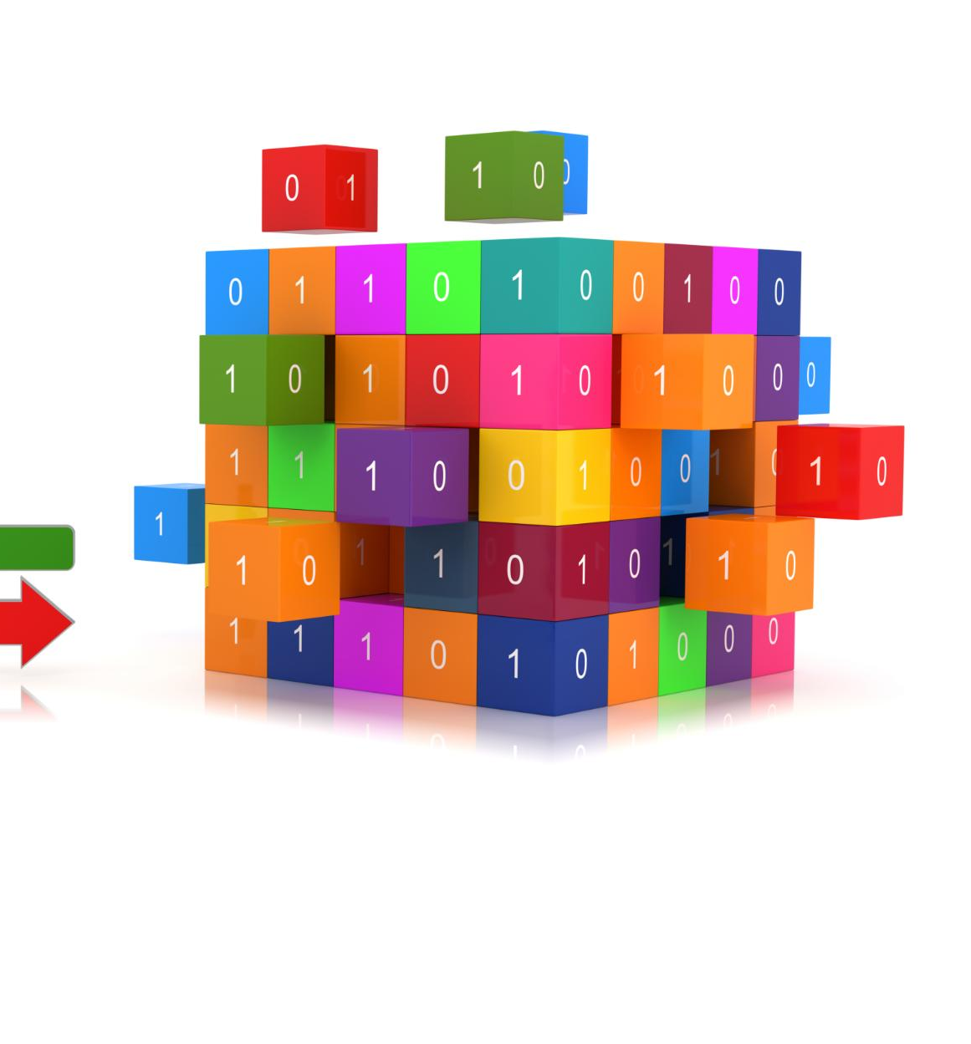
Indexing and Querying Data
Automatic Indexing System
Cloud Datastore utilizes an automatic indexing system to enhance the efficiency of data querying operations.
Optimizing Query Performance
Leveraging indexing effectively is crucial for optimizing query performance, reducing response times, and improving data retrieval accuracy.
Notes:
Cloud Datastore uses an automatic indexing system to facilitate efficient querying of data. Understanding how to leverage indexing effectively is essential for optimizing query performance.

Slide 11
Getting Started with Cloud Datastore
Notes:
This section will guide you through the initial steps of setting up and using Cloud Datastore for your applications. We will cover project setup and entity management.

Slide 12
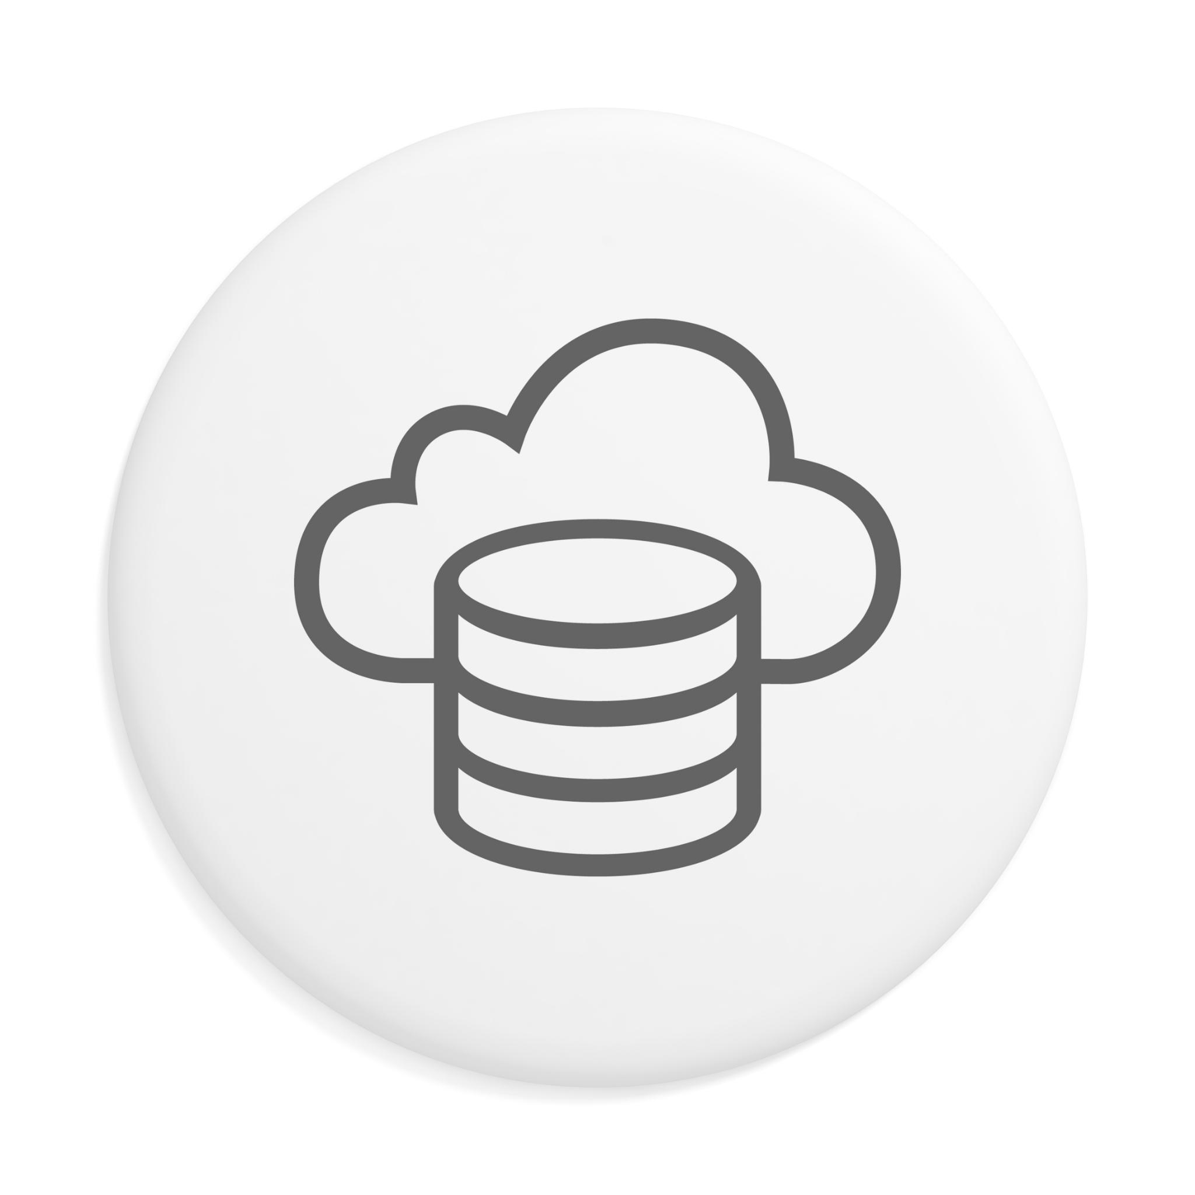
Setting up a GCP Project
Creating a Google Cloud Project
The first step is to create a new Google Cloud project, which serves as the foundation for using Cloud Datastore.
Setting Up Billing
Setting up billing is essential to utilize Google Cloud services, including the Cloud Datastore API.
Enabling Cloud Datastore API
After creating the project, enable the Cloud Datastore API to access its features and functionalities.
Configuring Permissions
Configure user permissions to ensure proper access to the Cloud Datastore service for your team.
Notes:
To use Cloud Datastore, you first need to create a Google Cloud project. This involves setting up billing, enabling the Cloud Datastore API, and configuring permissions to access the service.

Slide 13
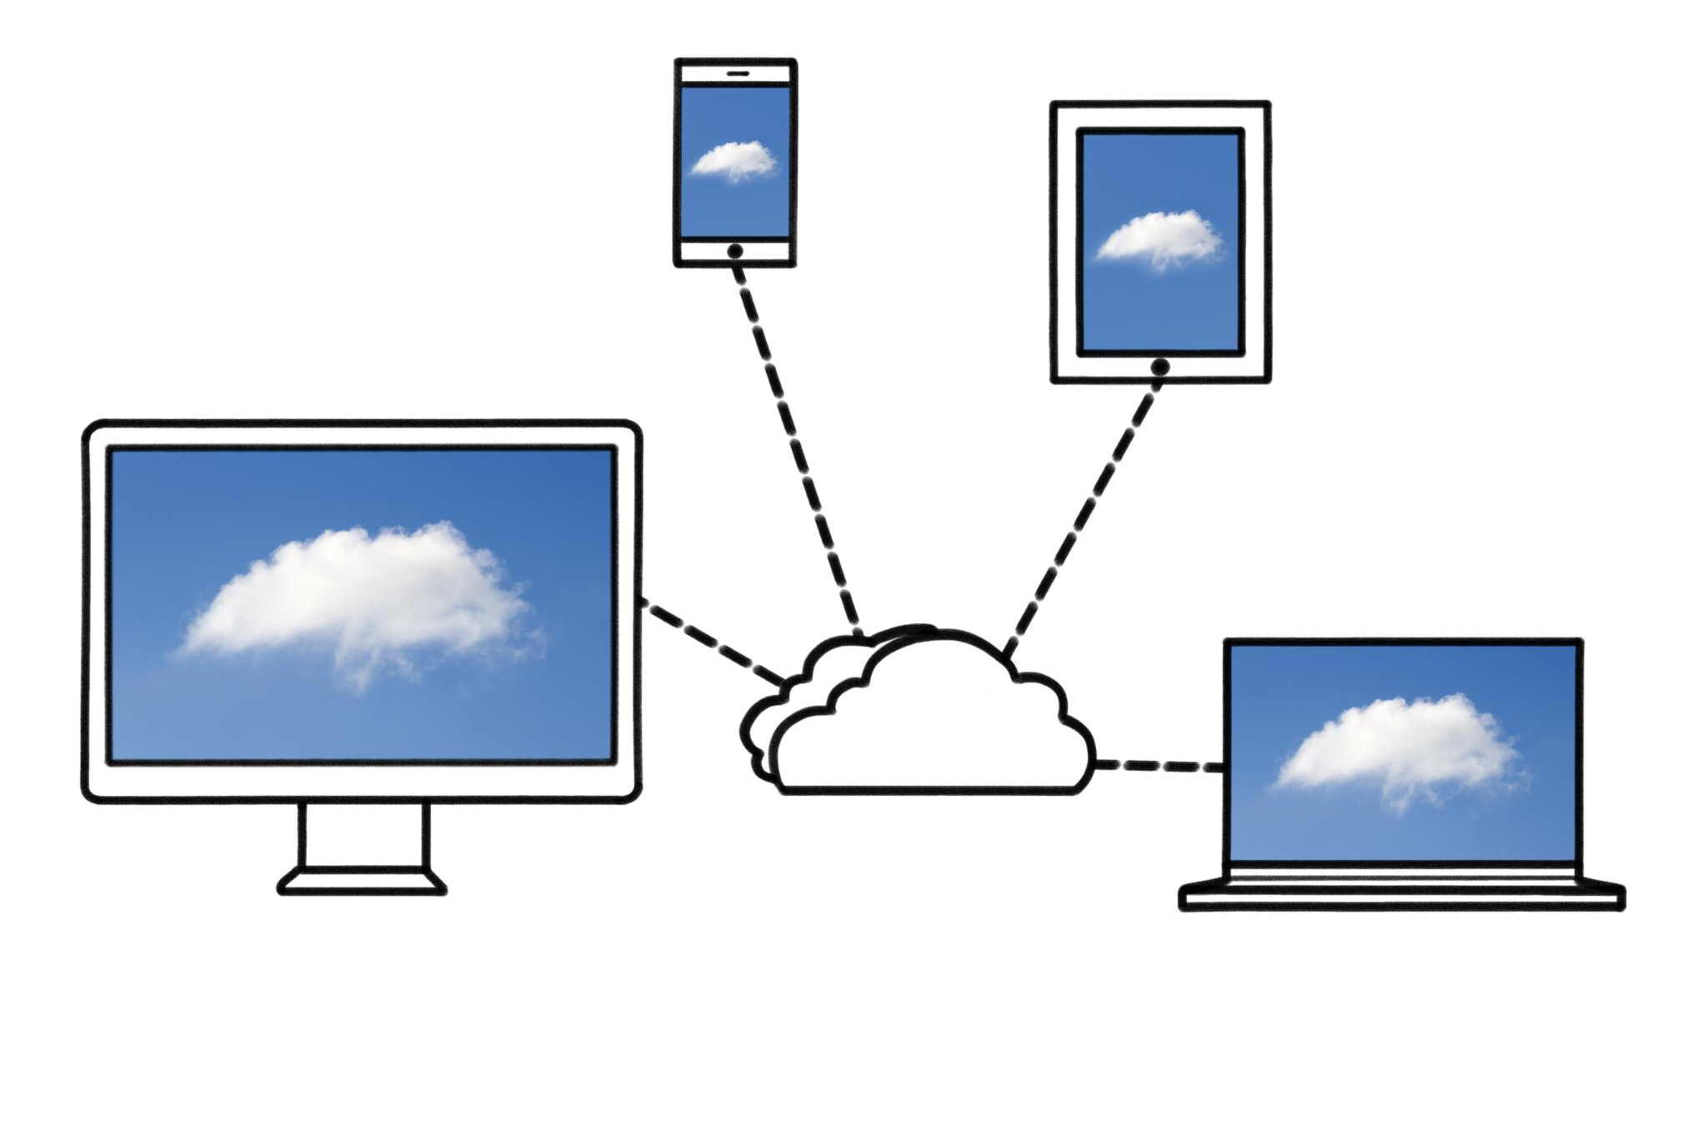
Creating and Managing Datastore Entities
Setting Up Entities
The first step involves creating entities within your Cloud Datastore project. Proper setup is crucial for effective data management.
Defining Kinds
Entities are categorized into kinds, which helps in organizing and retrieving data efficiently. This categorization is essential for structured data management.
Adding Properties
Each entity can have various properties that capture the data's attributes. Adding properties allows for detailed data management and retrieval.
Organizing Entities
Organizing entities effectively enhances data retrieval processes. Proper organization is key for performance and efficiency in data management.
Notes:
Once your project is set up, you can create and manage entities in Cloud Datastore. This includes defining kinds, adding properties, and organizing entities for efficient data retrieval.

Slide 14

Tools and Interfaces for Interacting with Datastore
Google Cloud Console
The Google Cloud Console provides a user-friendly interface for managing Cloud Datastore and other Google Cloud services.
Client Libraries
Client libraries allow developers to interact with Cloud Datastore programmatically, improving efficiency in application development.
RESTful APIs
RESTful APIs enable direct interaction with Cloud Datastore over HTTP, providing flexibility and control for developers.
Notes:
Cloud Datastore can be accessed through various interfaces, such as the Google Cloud Console, client libraries, and RESTful APIs. Familiarity with these tools is key to effective interaction with the database.

Slide 15
Use Cases and Best Practices
Notes:
This section explores common use cases for Cloud Datastore and provides best practices for data modeling and performance optimization to ensure efficient and scalable application development.

Slide 16

Common Use Cases for Cloud Datastore
Web Applications
Cloud Datastore is commonly used for web applications, allowing developers to store and retrieve data efficiently.
Mobile Applications
It supports mobile applications by providing scalable data storage that can adapt to user needs.
Content Management Systems
Cloud Datastore is ideal for content management systems, enabling efficient handling of unstructured content.
Notes:
Use cases for Cloud Datastore include web applications, mobile applications, and content management systems. Its ability to handle unstructured data and scale as needed makes it suitable for various applications.

Slide 17

Data Modeling Strategies
Data Structure Optimization
Properly structuring your data is crucial for enhancing performance and ensuring efficient queries in Cloud Datastore.
Using Entity Groups
Entity groups help in organizing related data and improving query performance, especially when using transactions.
Defining Relationships
Defining clear relationships between entities can reduce costs and enhance data retrieval efficiency.
Notes:
Effective data modeling strategies are essential for optimizing performance in Cloud Datastore. This includes understanding how to structure your data, use entity groups, and define relationships to minimize costs and maximize efficiency.

Slide 18

Performance Optimization and Scalability
Performance Optimization Strategies
Implementing performance optimization strategies is essential for smooth application operation and user experience.
Index Usage
Using indexes wisely can significantly enhance the performance of database queries by reducing access time.
Entity Group Management
Managing entity groups effectively is crucial for maintaining optimal performance and ensuring scalability.
Understanding Query Limits
Understanding query limits helps in designing scalable applications that can handle increased load without performance degradation.
Notes:
To ensure your application runs smoothly, it is important to implement strategies for performance optimization. This includes using indexes wisely, managing entity groups, and understanding query limits for scalability.

Slide 19
Integration and Advanced Features
Notes:
In this final section, we will look at how Cloud Datastore can be integrated with other GCP services and explore advanced features that enhance its capabilities.

Slide 20
Integration with Other GCP Services
Seamless Integration
Cloud Datastore integrates effortlessly with Google Cloud services, enhancing application development capabilities.
Application Development Ecosystem
The integration creates a robust ecosystem that supports efficient application development and deployment.
Data Analytics Enhancement
Integration with BigQuery allows for advanced data analytics, making data-driven decisions easier.
Notes:
Cloud Datastore seamlessly integrates with other Google Cloud services, such as Google App Engine, Cloud Functions, and BigQuery. This allows for a robust ecosystem for application development and data analytics.

Slide 21
Using Datastore in Applications and Workflows
Streamlining Data Management
Integrating Cloud Datastore simplifies data management by providing a scalable and efficient solution for your applications.
Enhancing Application Workflows
Cloud Datastore enhances application workflows by enabling real-time data access and improved collaboration among users.
Successful Implementation
Understanding the features of Cloud Datastore is essential for successful implementation and maximizing its benefits for your projects.
Notes:
Incorporating Cloud Datastore into your applications can streamline data management and enhance application workflows. Understanding how to utilize its features is key to successful implementation.

Slide 22
Advanced Features Like Transactions and Access Control
Multi-Entity Transactions
Multi-entity transactions allow operations across multiple entities, ensuring data integrity and consistency in applications.
Fine-Grained Access Control
Fine-grained access control enables precise permissions for users, enhancing security and protecting sensitive data.
Enhanced Security Features
These advanced features add layers of functionality that improve the security posture of applications built on Cloud Datastore.
Notes:
Cloud Datastore supports advanced features such as multi-entity transactions and fine-grained access control. These features provide additional layers of functionality and security for applications built on this platform.

Slide 23
Conclusion
Powerful NoSQL Database
GCP Cloud Datastore offers a robust NoSQL database solution that supports highly scalable applications.
Scalability and Flexibility
The service provides scalability and flexibility, allowing developers to adapt to changing application demands effortlessly.
Ease of Use
GCP Cloud Datastore is designed with user-friendliness in mind, making it accessible for developers of all levels.
Notes:
In conclusion, GCP Cloud Datastore is a powerful NoSQL database service that offers scalability, flexibility, and ease of use. By understanding its architecture, features, and best practices, developers can leverage Cloud Datastore to build robust applications.

